Slide 1
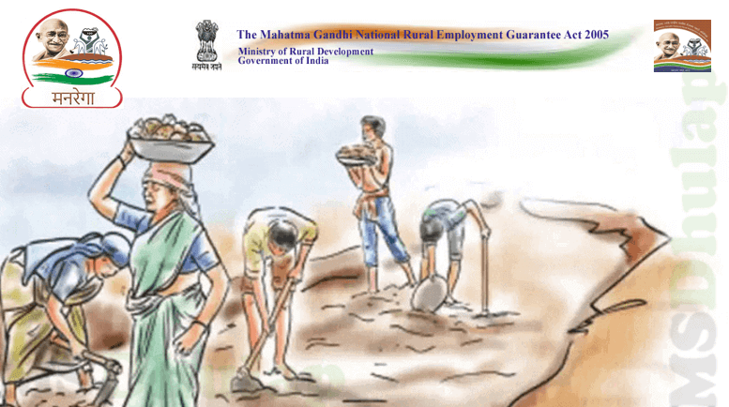

NREGA Analysis with Power BI
By. ANNU JHA
Batch Name – MIP-DA-09

Slide 2
PROJECT OVERVIEW
National Rural Employment Guarantee Act is an Indian social welfare government scheme aimed at providing rural households with guaranteed wage employment opportunities. It aims to enhance livelihood security in rural areas by providing at least 100 days of wage employment in a financial year to at least one member of every household whose adult members volunteer to do unskilled manual work. The objective of this project analysis is to gain valuable insights into the implementation and impact of NREGA across different states and districts in India which will help guide policymakers for scheme optimization

Slide 3
PROBLEM STATEMENT
NREGA is a vital initiative to alleviate rural unemployment and poverty. This project seeks to address several key questions and challenges associated with NREGA:
How effective is NREGA in providing employment opportunities to rural households?
Are there regional disparities in the implementation and outcomes of the scheme?
What is the utilization of the allocated budget, and how does it correlate with employment generation?
What are the key factors contributing to the completion of NREGA works, and are there any roadblocks to its success?
Can data-driven insights guide policymakers and administrators in optimizing the scheme's impact?

Slide 4
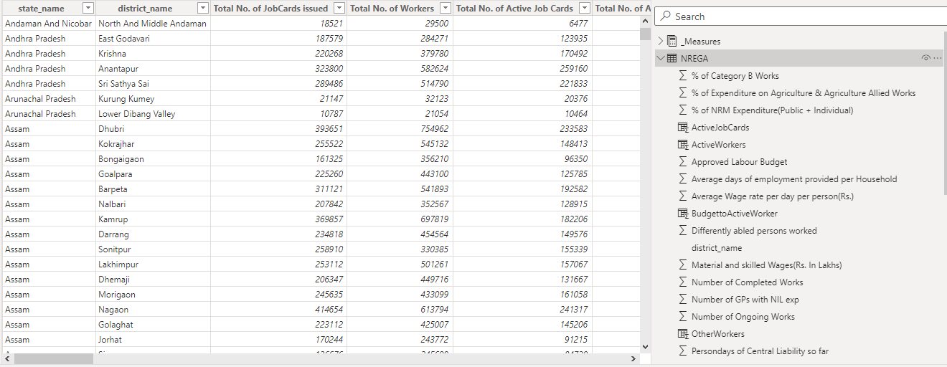
DATASET

Slide 5
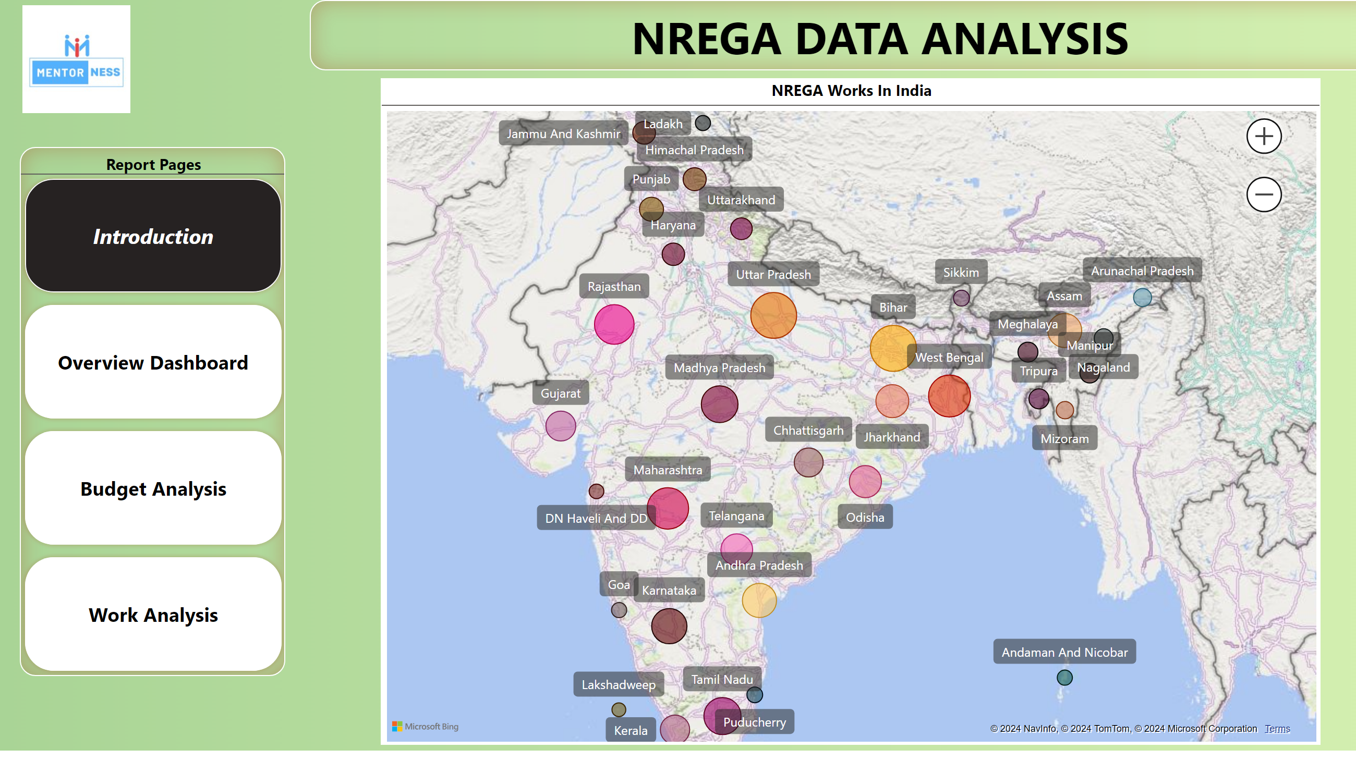
DATA VISUALIZATION
LIVE DASHBOARD

Slide 6
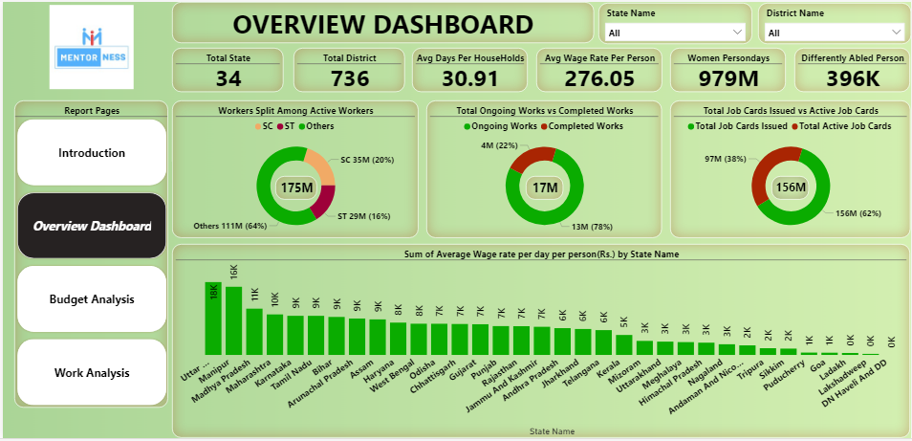
DATA VISUALIZATION

Slide 7
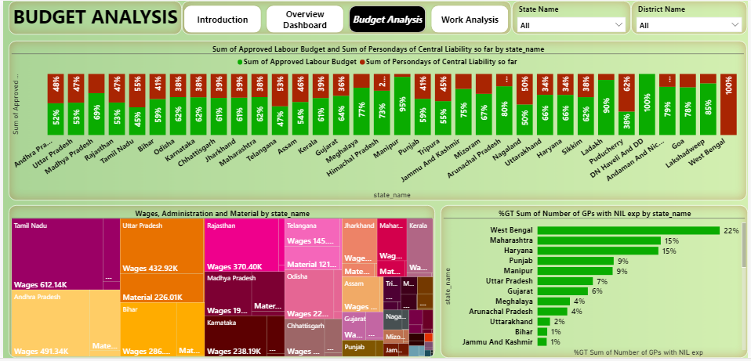
DATA VISUALIZATION

Slide 8
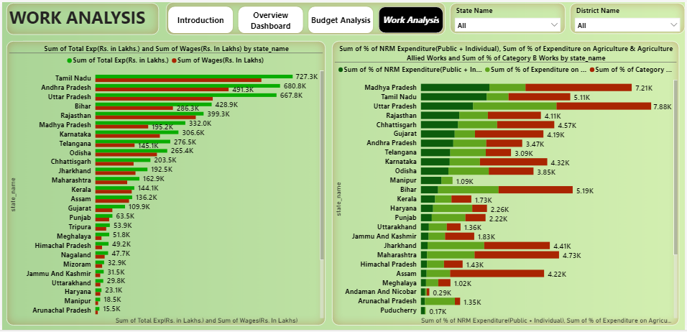
DATA VISUALIZATION

Slide 9
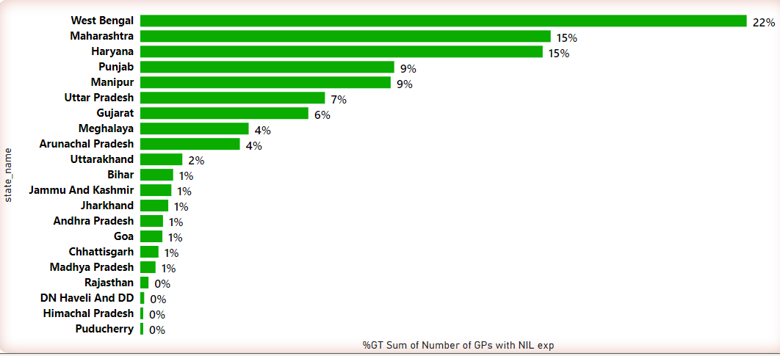
PS1: How effective is NREGA in providing employment opportunities to rural households?
We have so many gram panchayat with nil expenditure.22 % in West Bengal , Maharashtra and Haryana 15 % .In these three states GPs with nil expenditure is more than 10% hence it has been in effective

Slide 10
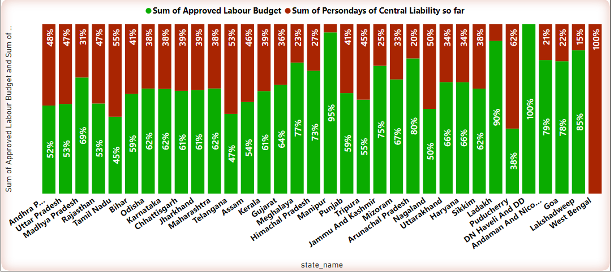
PS2: Are there regional disparities in the implementation and outcomes of the scheme?
There is regional disparity , no approved labour budget in West Bengal , so much liability. Liabilities are also high in Southern region of Telangana , Tamil Nadu and Pondicherry all above 50%

Slide 11
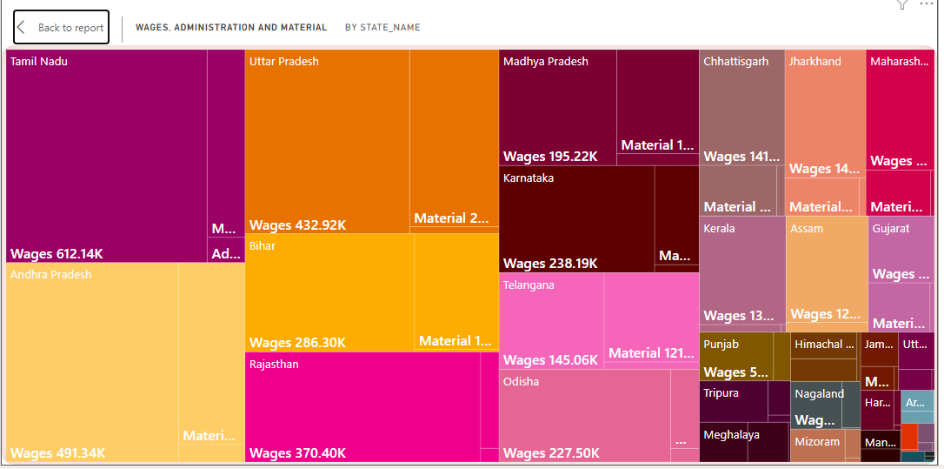
PS 3: What is the utilization of the allocated budget, and how does it correlate with employment generation?

Slide 12
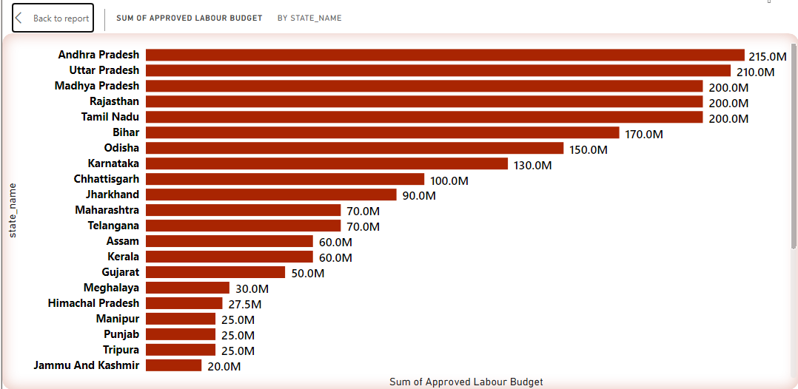
PS4: What are the key factors contributing to the completion of NREGA works, and are there any roadblocks to its success?
Disparity in average wages across state
Some states have very few completed works and more ongoing
Focusing on providing more than 100 days to households
Focus on GPs with no expenditure
Expediting clearance of central liability

Slide 13
PS5:Can data-driven insights guide policymakers and administrators in optimizing the scheme's impact?
Yes it does help
It helps find outliers
Focus on states and districts where completed work is very less compared to ongoing find bottleneck
Reduce central liability and try to maintain below 30% so that payment happens on time
Focus on GPs where there is no expenditure
Reduce administrative expenses
Focus on equality of wages ensuring income equality
To ensure the ratio of active job card / total issued card is high and more people take advantage of the scheme

Slide 14
Live DASHBOARD
THANKYOU

